Slide 1
Multipopulation harmony search algorithm for the detection of high-order SNP interactions
, ,
Tuo, S., Liu, H. and Chen, H., 2020. Multipopulation harmony search algorithm for the detection of high-order SNP interactions. Bioinformatics, 36(16), pp.4389-4398.
Presented by Kazimieras Jasaitis
MIF, VU, BioInformatika IV kursas

Slide 2
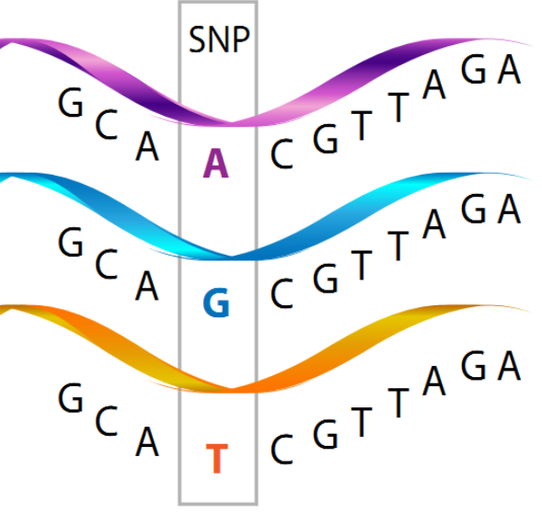
SNP
Single nucleotide polymorphysm
In a person’s genome, there are >3 million SNPs.

Slide 3
High-order SNP interactions
Interaction of multiple SNPs
High-order SNP interaction represents a combination of multiple SNPs that influence complex diseases linearly or nonlinearly, and detection is of great importance in identifying the pathogenic causes of complex diseases in humans

Slide 4
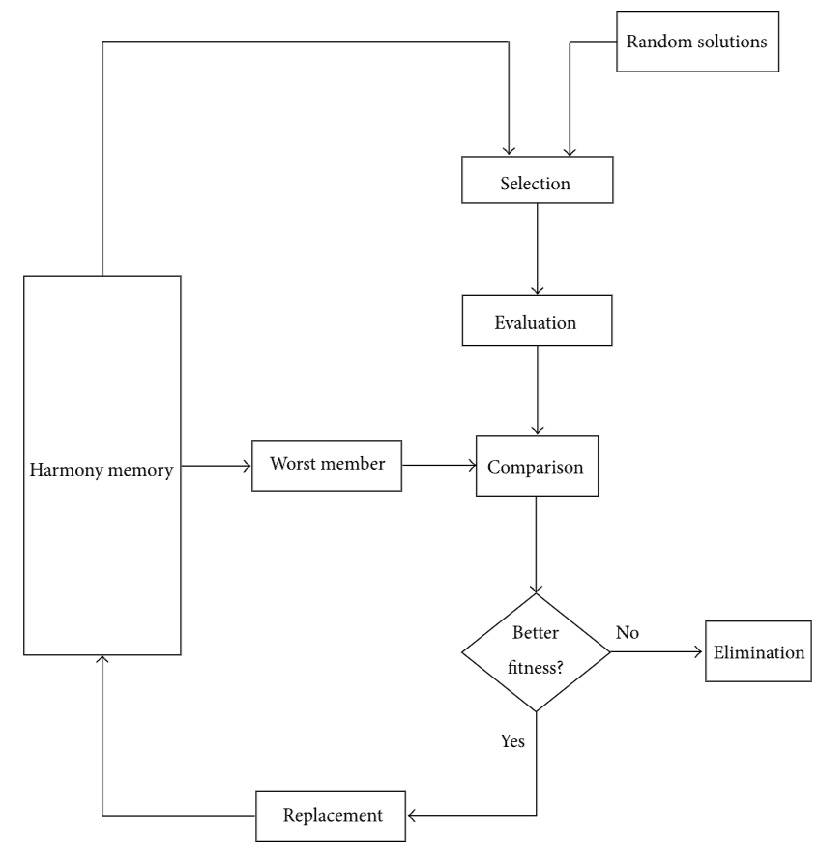
Harmony Search (HS) algorithm
SIO – swarm intelligence optimisation
Parameters:
HM – Harmony Memory
HMCR – Harmony Memory Considering Rate
PAR – Pitch Adjusting Rate
BW – BandWidth
[2] Harmony Search Method 2015

Slide 5
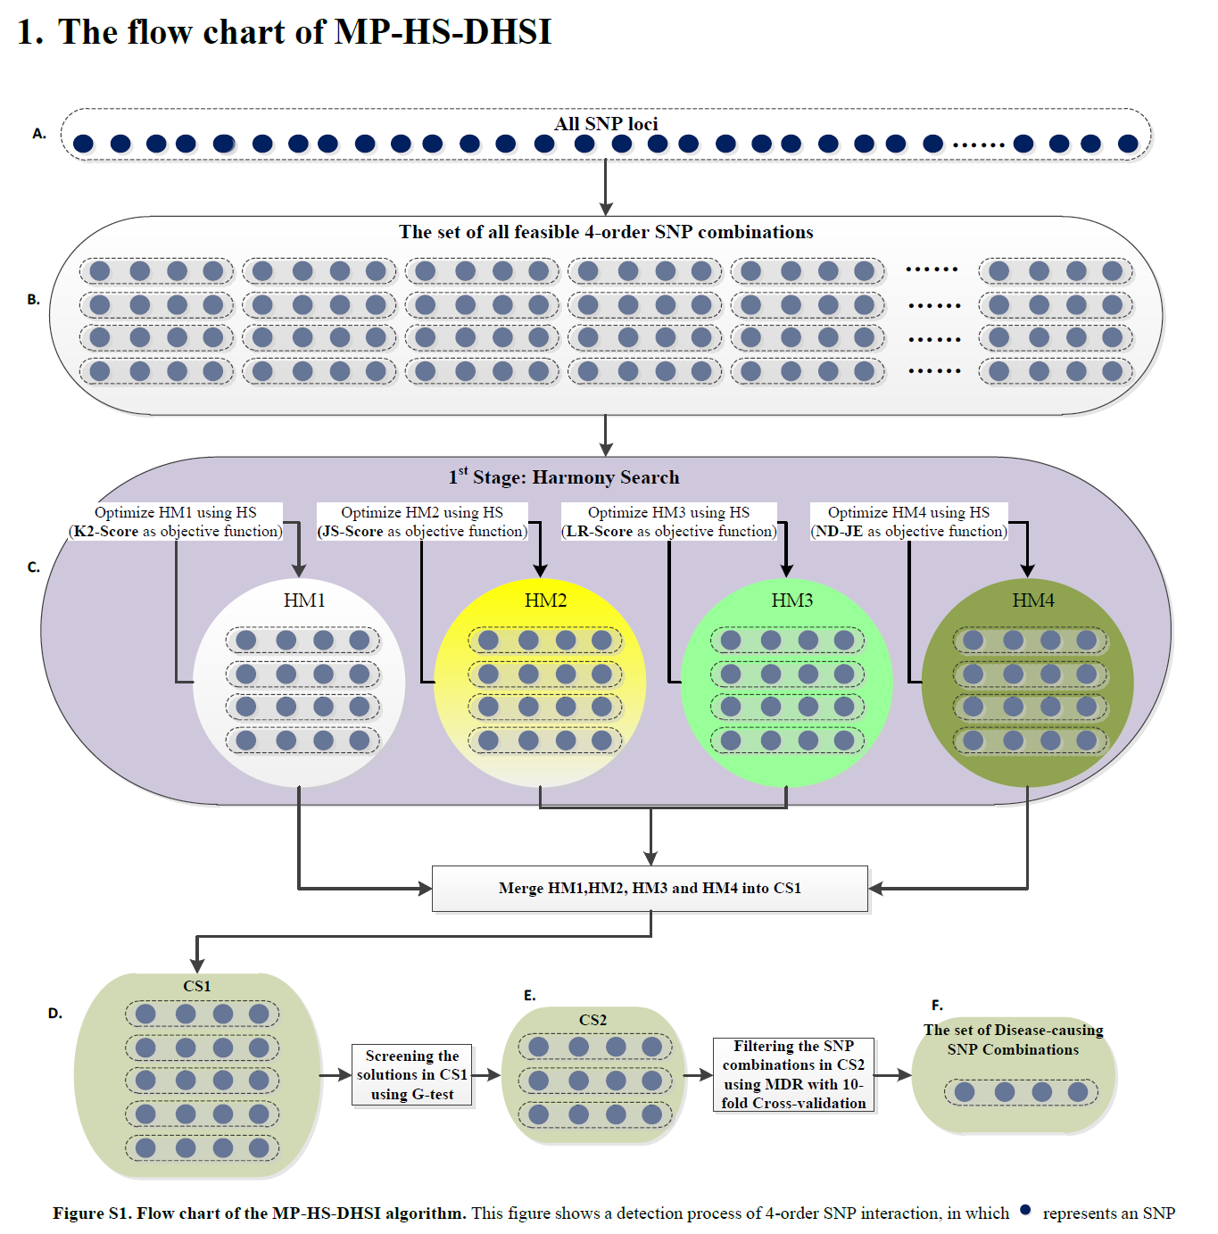

Slide 6
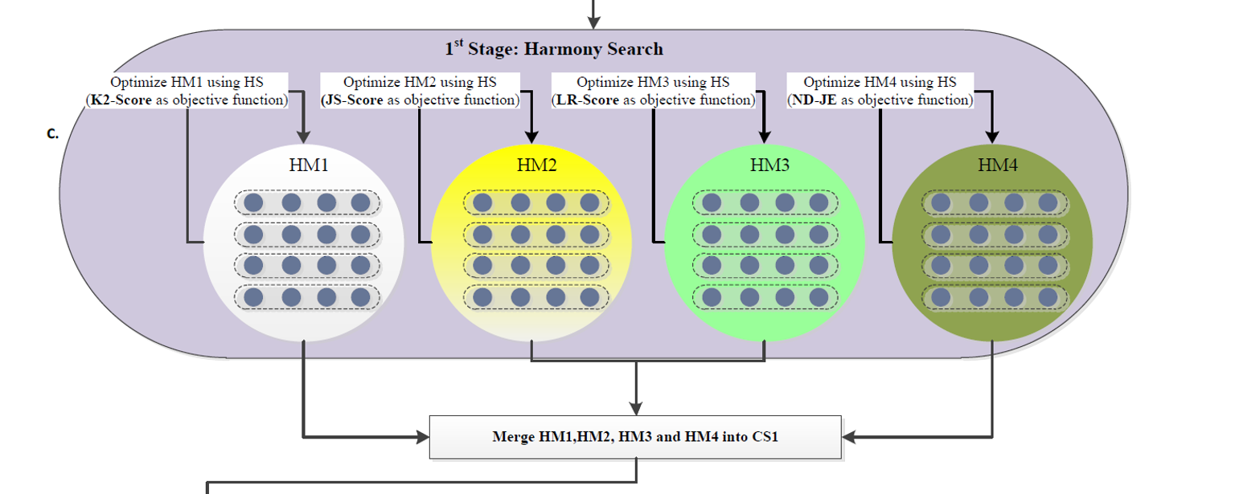
Multiple Objective functions

Slide 7
Results
Performs almost as well as exaustive search
Effective in quickly finding high-order SNP combinations for DMEs
Does not perform as well with disease models with no marginal effects (DNMEs). (only 2-order SNP interactions)

Slide 8
[1] Tuo, S., Liu, H. and Chen, H., 2020. Multipopulation harmony search algorithm for the detection of high-order SNP interactions. Bioinformatics, 36(16), pp.4389-4398.
[2] Gao, X.Z., Govindasamy, V., Xu, H., Wang, X. and Zenger, K., 2015. Harmony search method: theory and applications. Computational intelligence and neuroscience, 2015, pp.39-39.

